Slide 1
Classification of Stars and quasars
Venugopal n b
Chetan b chavhannavar
Anirudh joshi

Slide 2
Classification model K-Nearest neighbours
A k-nearest-neighbor algorithm, is an approach to data classification that estimates how likely a data point is to be a member of one group or the other depending on what group the data points nearest to it are in.
We have used Euclidean distance to find the nearest neighbor.
Class value to which most of the k-neighbours belong is taken as the prediction.

Slide 3
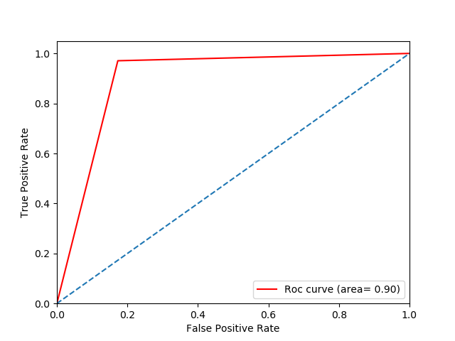
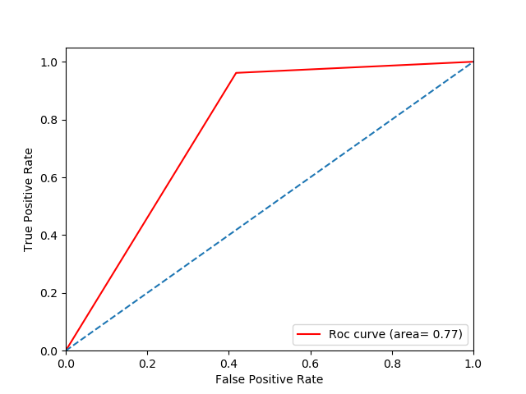
Why knn ? AUC-ROC curve comparison
knn
Naïve-bayes

Slide 4
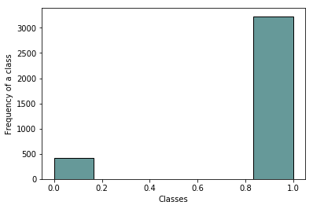
Imbalanced classes
Our Dataset had large number of Quasars compared to Stars.
By this,we can get an excellent accuracy by just saying all objects are quasars.(known as Accuracy Paradox).

Slide 5
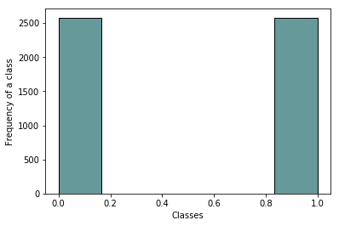
Up sampling / down sampling
Upsampling is a process where minority class (stars) observations are randomly duplicated with replacement.
Where as randomly removing observations from majority class is downsampling.
Now our dataset is balanced with equal number of classes.

Slide 6
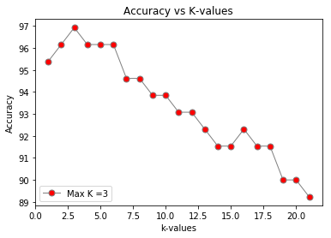
Why k=3 ?
The plot shows the accuracy for different k values.
The accuracy is maximum for k=3,after which the accuracy decreases.
Thus the model predicts well for k=3.

Slide 7
K-fold Cross validation
In K Fold cross validation, the data is divided into k subsets. one of the k subsets is used as the test set/ validation set and the other k-1 subsets are put together to form a training set.

Slide 8
Model accuracy and time
Dataset | Normal |  | Cross-Validation
 | Accuracy | Time (sec) | Accuracy | Time (sec)
Cat1.csv | 95.38 | 0.664 | 95.84 | 1.817
Cat2.csv | 93.03 | 24.03 | 93.47 | 63.016
Cat3.csv | 93.71 | 50.99 | 94.11 | 95.870
Cat4.csv | 85.13 | 1805 | - | -

Slide 9
Thank you

